Slide 1
On Collaborative Development and Execution of Clinical Natural Language Processing Pipelines Through the OHNLP Toolkit
Session: W03
Andrew Wen, Sunyang Fu, Liwei Wang, Hongfang Liu
Center for Translational AI Excellence and Applications in Medicine
McWilliams School of Biomedical Informatics, UTHealth Houston

Slide 2




Sunyang Fu, PhD, MHI
Assistant Professor
Center of TEAM-AI, UTHealth Houston
Hongfang Liu, PhD
Professor and Director, Center of TEAM-AI, UTHealth Houston
Liwei Wang, MD, PhD
Associate Professor
Center of TEAM-AI, UTHealth Houston
Andrew Wen, MS
Data Scientist II
Center of TEAM-AI, UTHealth Houston

Slide 3
Learning Objectives
Understand how to compose symbolic NLP rulesets using the OHNLP toolkit to extract information of clinical interest from unstructured clinical narratives
Understand how to configure/deploy OHNLP toolkit components to allow for integration with institution-local data repositories and infrastructure
Understand how to evaluate and further iterate on developed rulesets in a federated and community-consensus driven context in compliance with RITE-FAIR principles for reproducible and transparent research data.

Slide 4
Agenda
Introduction to Clinical NLP and the OHNLP Consortium (Liu - 15 min)
Barriers to adoption/implementation of Clinical NLP (Fu - 15 min)
An introduction to components in the OHNLP ecosystem (Wen - 15 min)
Break (15 min)
Hands-on:
A walk-through of installing/deploying the OHNLP Toolkit on your institutional infrastructure (Wen - 20 min)
NLP algorithm development process (Fu and Wang - 15 min)
Gold standard annotation using MedTator (Wang - 10 min)
Break (15 min)
NLP Ruleset Development using the MedTagger Web Interface (Fu - 12 min)
Evaluation of NLP output using MedTator (Wang - 12 min)
Installing Third Party Components to add De-Identification to the Pipeline (Wen - 10 min)

Slide 5
Introduction to Clinical NLP and the OHNLP Consortium
Hongfang Liu, PhD
Director, Center of Translational AI Excellence and Applications in Medicine
Vice President, Learning Health System
University of Texas Health Science Center Houston

Slide 6
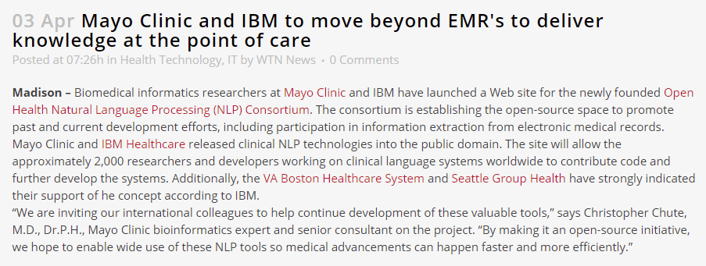
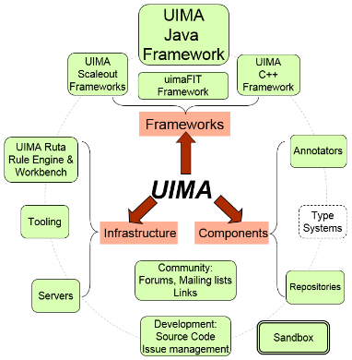


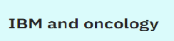
2009
https://wtnnews.com/2009/04/03/5840/
IBM’s medKAT systems (medical Knowledge Analysis Tool) is a system to extract structured information from unstructured data sources, such as pathology reports, clinical notes, discharge summaries and medical literature.
cTAKES functionality recognizes whether a clinical concept is negated, relevant to the patient or to the patient’s family, which are attributes critical to understanding patient-centered medical language.

Slide 7

Secondary Use of EHR Information (SHARPn)
PI: Chris Chute
Develop tools and resources to facilitate effective use of electronic clinical data captured by EHRs and similar systems.

Slide 8
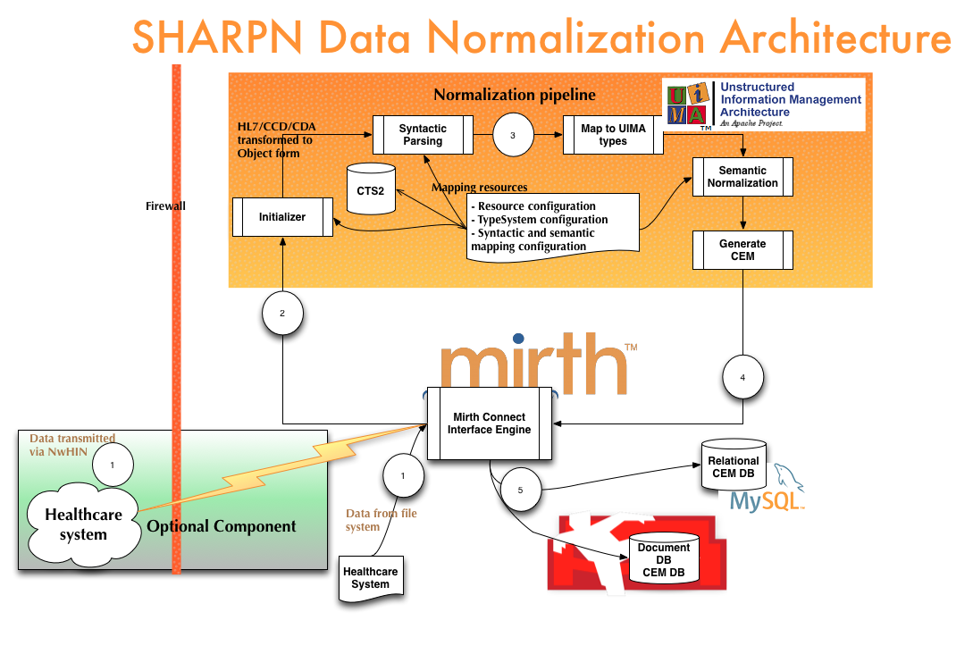
2010 - 2013

Slide 9
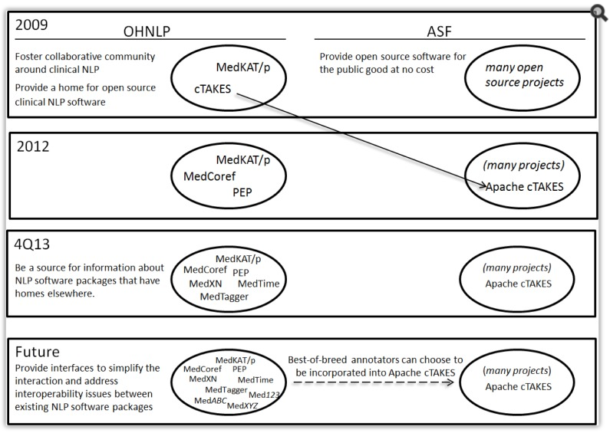
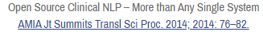
Open Source Clinical NLP
2013
http://www.ohnlp.org
https://github.com/OHNLP

Slide 10
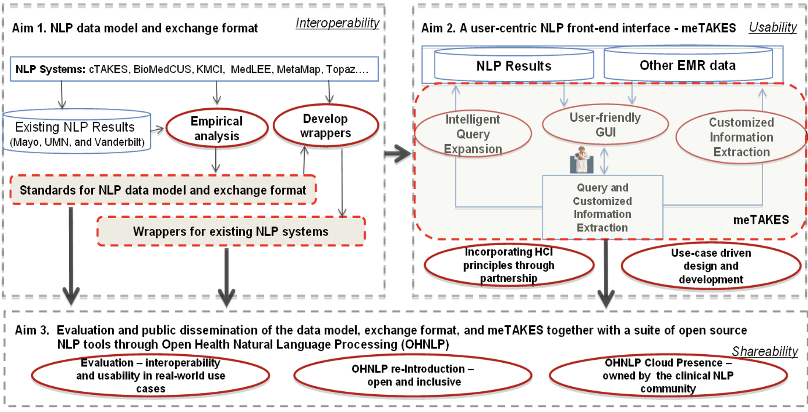
NLP for Clinical and Translational Research NIGMS R01
2014 - 2017

Slide 11






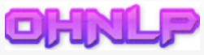

Clinical and Translational Science Institute (University of Minnesota)
Center for Clinical and Translational Science (Mayo Clinic)
Irving Institute for Clinical and Translational Research (Columbia University)
Center for Clinical and Translational Sciences (UT Health)
2017 - 2023
U01TR002062
Open Health
Natural Language
Processing
Collaboratory
Partnership
Team
Aim 1: Obtain NLP artifacts across sites for improving NLP algorithm development
Aim 2: Generate a synthetic text corpus for exploratory analysis of clinical narratives
NLP Innovations
Aim 3: Develop privacy-preserving computational phenotyping enhanced with NLP
Aim 4: Partner with diverse communities for translation science excellence leveraging EHR
Privacy-Preserving Computing
Computational Phenotyping

Slide 12
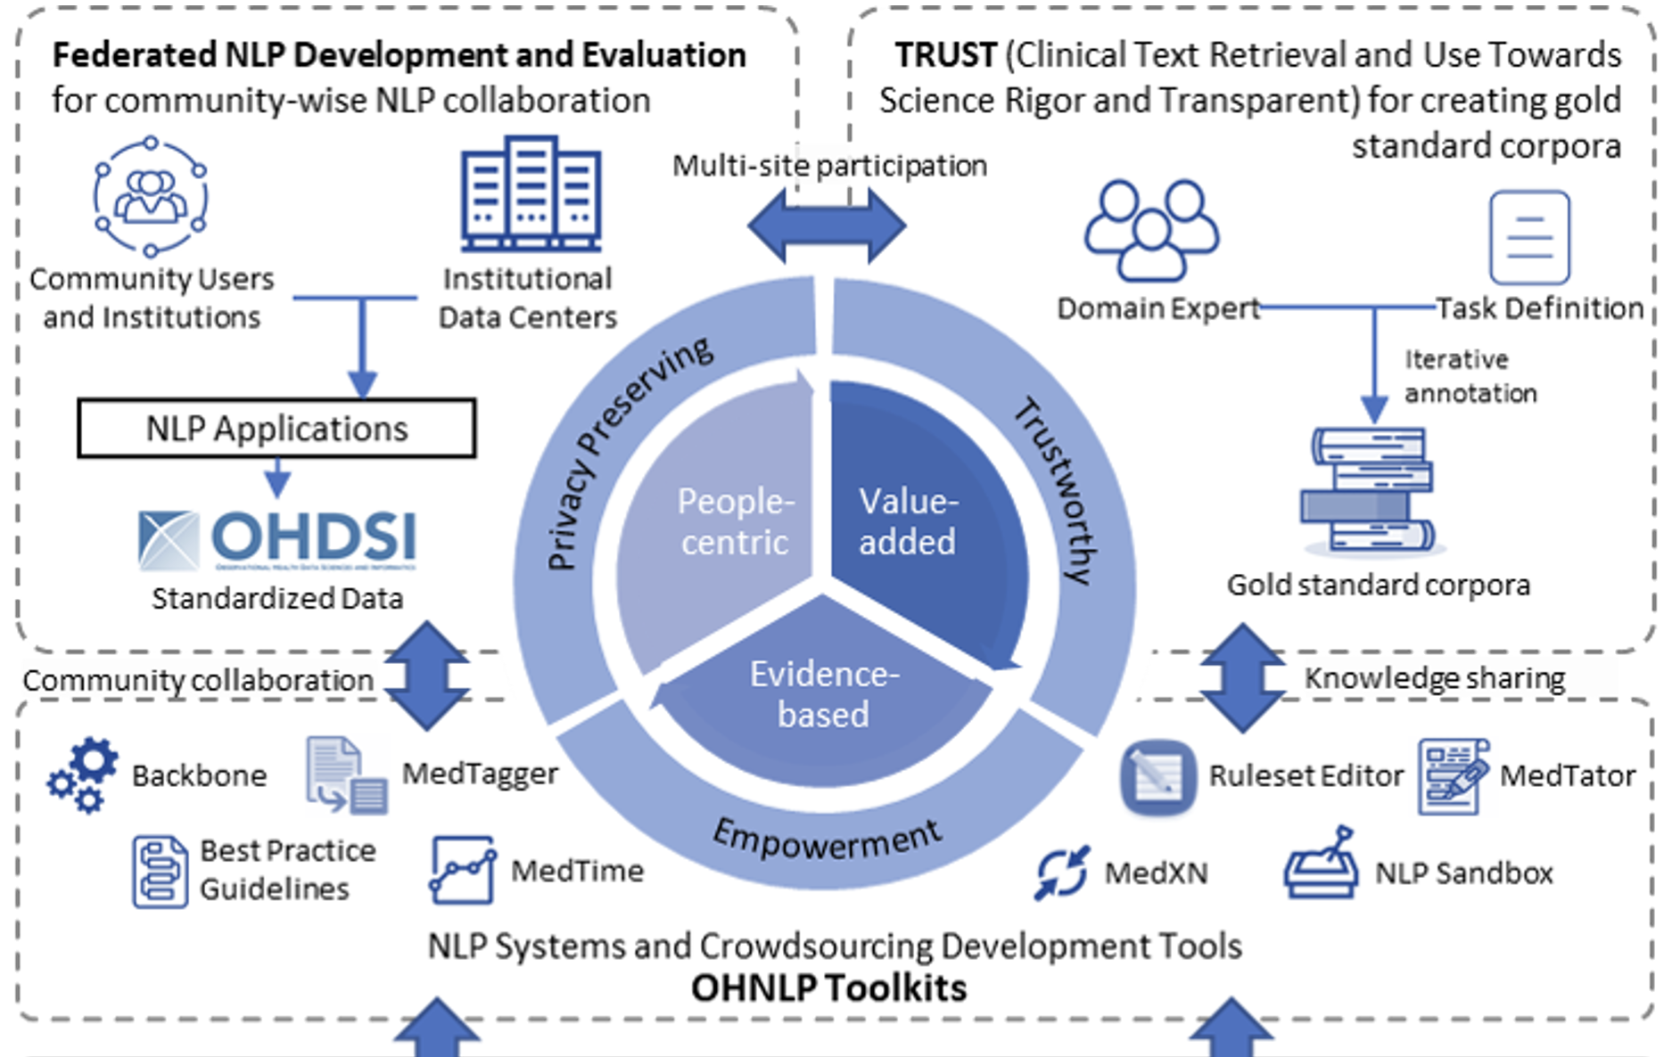
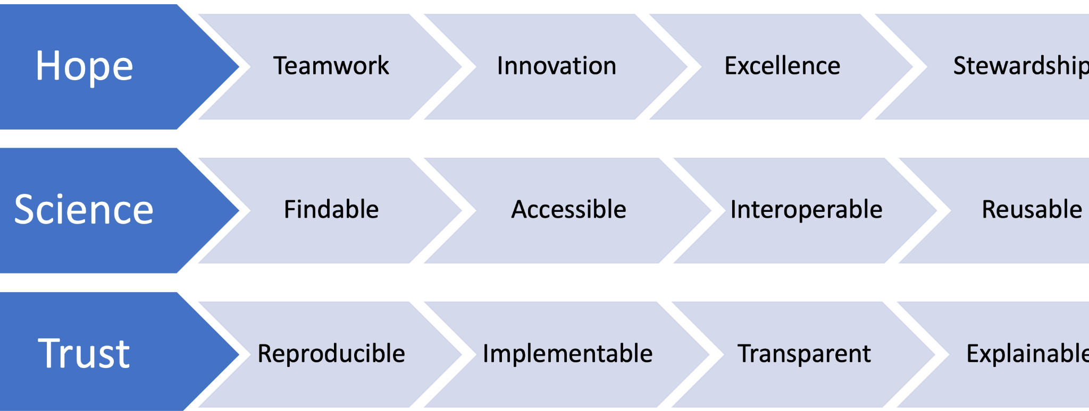
2023

Slide 13

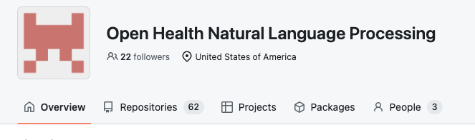






Promoting Open NLP Communities

Slide 14
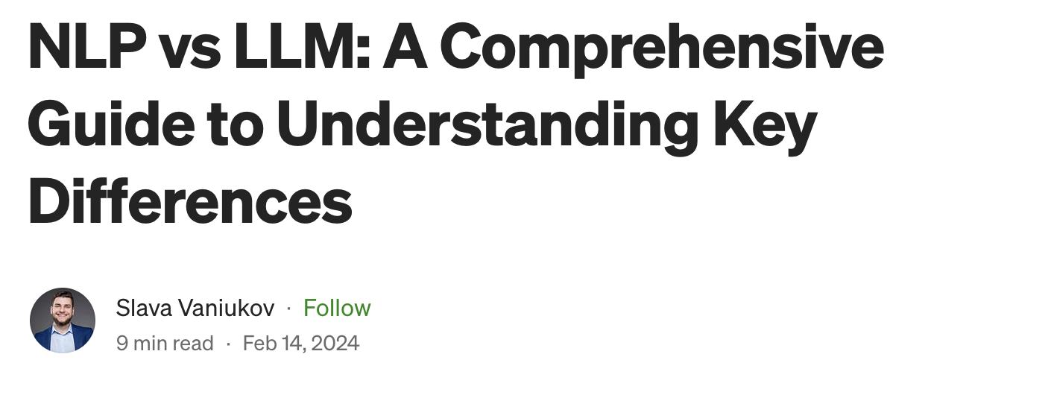
2024
https://medium.com/@vaniukov.s/nlp-vs-llm-a-comprehensive-guide-to-understanding-key-differences-0358f6571910

Slide 15
Barriers to adoption/implementation of Clinical NLP
Sunyang Fu, PhD, MHI
Center for TEAM-AI, Department of Clinical and Health Informatics
McWilliams School of Biomedical Informatics, UTHealth Houston

Slide 16
NLP Applications for Clinical Research
Planning and Assessment
Activation and Execution
Reporting
Study Design
Feasibility
Study Cohort
Data Collection
Data Analysis
Outcome Dissemination
NLP-assisted feasibility assessment
Automatic eligibility criteria screening
Information extraction from EHRs
Text mining for content analysis
NLP can be integrated into the research workflow for clinical research studies by providing information extraction and knowledge conversion at multiple stages of study implementation
Fu S, Wang L, Moon S, Zong N, He H, Pejaver V, Relevo R, Walden A, Haendel M, Chute CG, Liu H. Recommended practices and ethical considerations for natural language processing‐assisted observational research: A scoping review. Clinical and translational science. 2023 Mar;16(3):398-411.

Slide 17
Learning Health Systems (LHS)
3. Cohort Screening
4. Data Collection
The Rapid Adoption of EHR Drives Clinical Research
LHS: Continuously Converting Data into Knowledge and Translate into Patient Care
Outer loop: clinical research lifecycle
Inner loop: LHS learning cycles
2. Feasibility
Data to Knowledge
Knowledge to Performance
5. Data Analysis
Performance to Data
1. Study Design
6. Outcome Dissemination
7. Knowledge Management
Friedman CP, Wong AK, Blumenthal D. Achieving a nationwide learning health system. Science translational medicine. 2010 Nov 10;2(57):57cm29-.

Slide 18
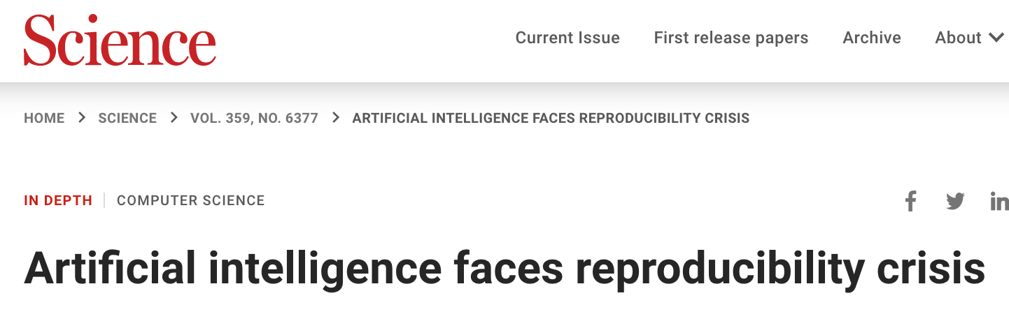
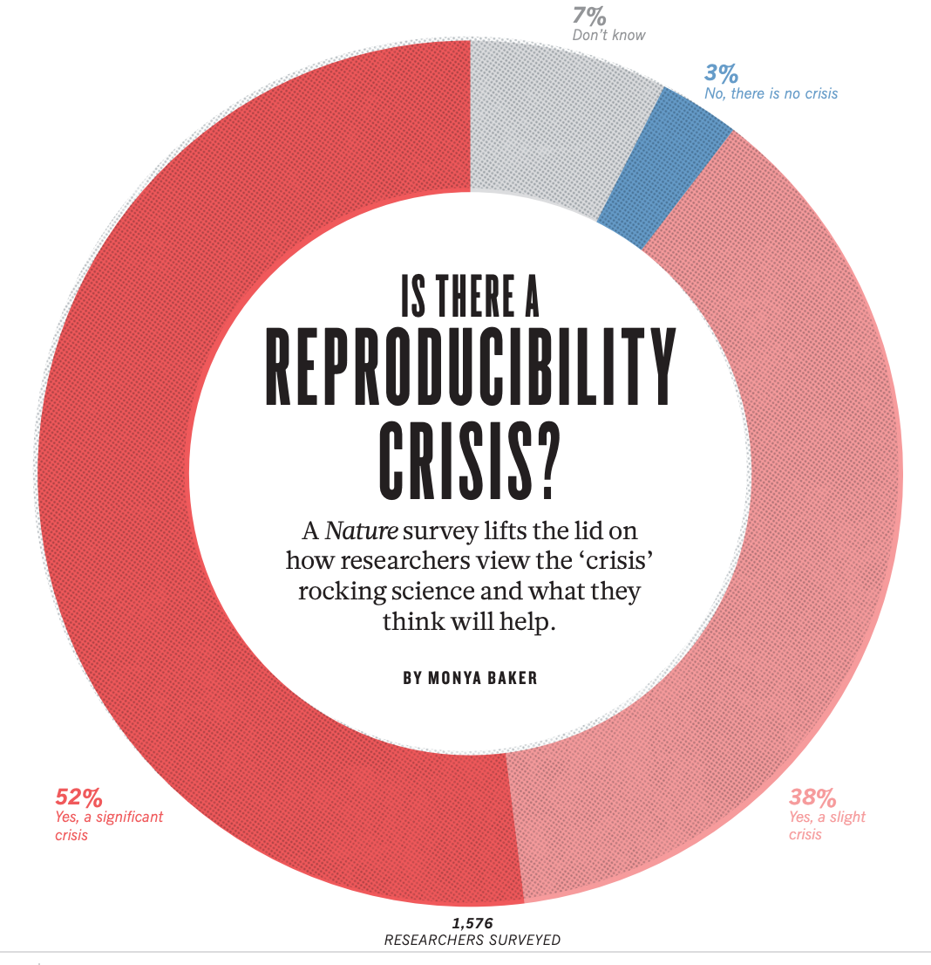
Model Reproducibility
Secondary use of EHRs
Patient care
EHR
Data collection
Data use
Data reporting
Reproducibility challenges
Practice variation
EHR heterogeneity and complexity
Data silo and lack of semantic interoperability
No data and code sharing
Lack of reporting standard
Downstream implications
Process: transparency and variability
Outcome: interpretability, variability, and validity
(Hutson, 2018)
Notes:
Despite the promising results, there are been criticism of AI reproducibility challenges. In the context of the secondary use of EHRs for the development, evaluation, and deployment of predictive models, potential reproducibility challenges can link to various data quality issues due to the high heterogeneity of the EHR environment. Since clinical predictive models are high-stakes applications, the output of the models could directly affect the validity of findings, explainability of decisions, and the safety of clinical practice.

Slide 19
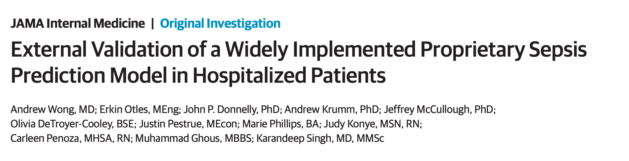
Model Portability
Issues continue with the integration of informatics and AI in clinical environment
The evaluation conducted on the Epic sepsis model on a large-scale cohort of 27,697 patients
The observed model performance (AUC, 0.63)
Internal documentation (AUC, 0.76-0.83)
(Wong et al, 2021)
Notes:
A recent study evaluated the Epic sepsis model on a large-scale cohort. The observed model performance was substantially lower than the reported performance. From the perspective of implementation and translational science, the primary issue was not only the degradation of performance but also the direct deployment of the model without a proper definition of EHR data elements, lack of detailed instructions on how the model can be used, customized, and interpreted, as well as best practices to deal with data quality issues in the context of the clinical problem that the model is designed for

Slide 20
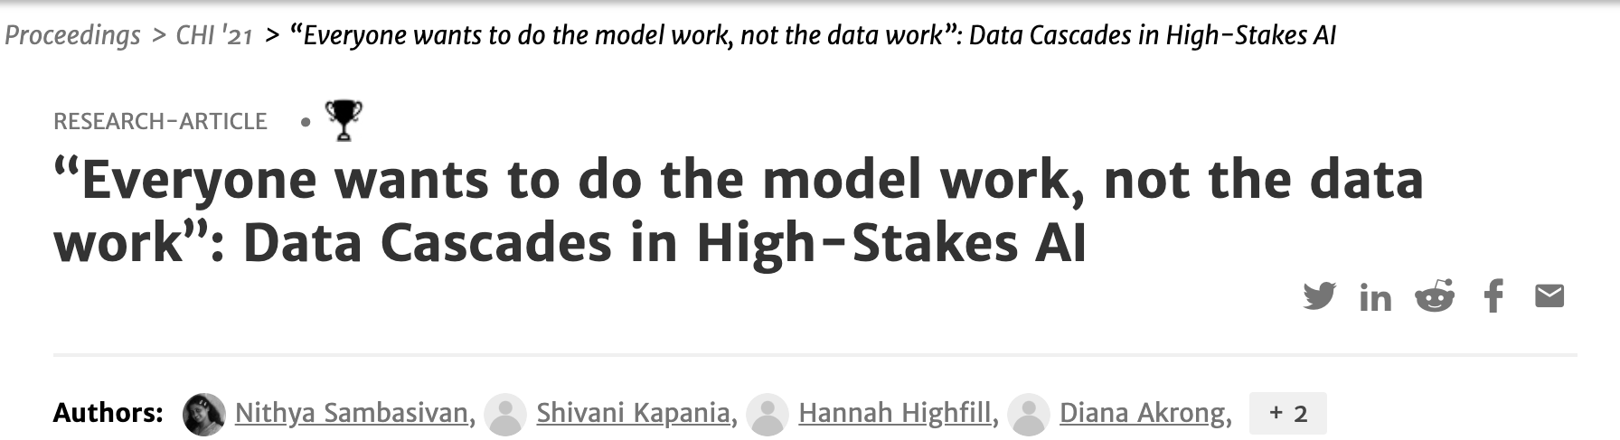
Data Cascades
“We observe that data cascades often originate early in the lifecycle of a machine learning system, at the stage of data definition and collection.”
(Sambasivan, 2021,CHI)
Notes:
Such an issue was also emphasized in the HCI community, naming the challenge of data cascading, defined as the downstream effects from data issues that result in technical debt over time, which also emphasizes the importance of making sure data work properly prior to the modeling effort.

Slide 21
Heterogeneity of EHR Settings
EHR systems, processes and environments have a significant impact on the form and format of clinical data
EHR Systems
Standard and Interoperability
Built-in functionality
Templates
Smart forms
Copy and paste
Auto-documentation
Transcription
Data Documentation, Collection, and Extraction Process
Information collection and use
Contextual factors (e.g., ICU vs. non-ICU)
Human factors (e.g., varying levels of medical expertise and training)
Institution
Data representation variation
ETL (extract, transform, and load) and abstraction process variation
Patient population variation
Care practice variation
…
Micro perspective
Macro perspective
Notes:
One key challenge for the translation of nlp into the clinical environment resides in the heterogeneity of EHR systems. Since EHR systems are deeply embedded within the patient care and the workflow of clinical data generation and management, the system itself has a significant impact on the form and format of clinical data, this includes …….. However, the implication of these heterogenous factors to predictive modeling is unclear. Our objective is to systematically examine the information quality variability across different EHR systems and to have a better understanding of these implications to further model development and use.

Slide 22
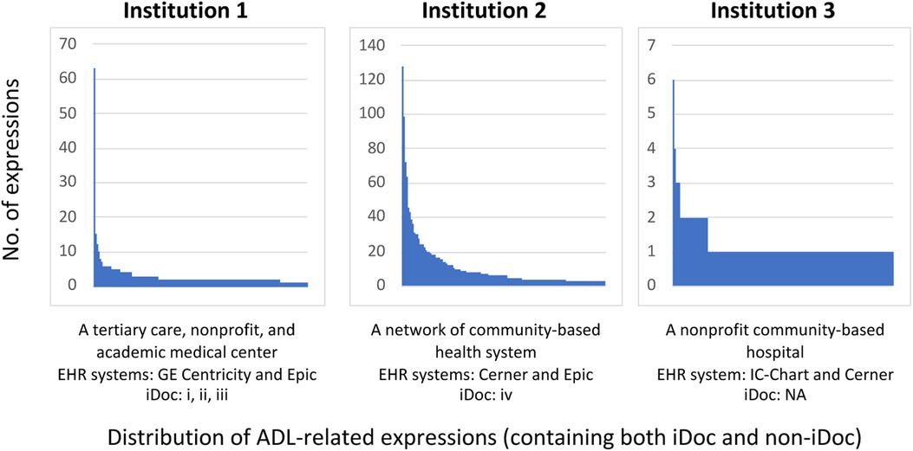
Variations in Clinical Documentation
Fu S, Vassilaki M, Ibrahim OA, Petersen RC, Pagali S, St Sauver J, Moon S, Wang L, Fan JW, Liu H, Sohn S. Quality assessment of functional status documentation in EHRs across different healthcare institutions. Frontiers in Digital Health. 2022 Sep 27;4:958539.

Slide 23
Contextual Factors to Consider for the NLP Development
Study population
Study scope
Study duration
Study type
Inclusion criteria (e.g., ICD, CPT codes, age, sex, duration)
Exclusion criteria (e.g., MRA, ICD, CPT, prior conditions)
Task formulation
Data retrieval
Cohort screening
Annotation guideline development
Annotation tool
Inter-reader reliability
Post annotation consensus
Case adjudication
Finalized annotation guideline
Finalized study corpus
Clinical guideline, definition
Pilot annotation
Guideline revision
Concept definition
Case sampling strategy
Annotation training
Annotation production
Corpus adjudication
NLP development
Experiment
Evaluation
Model deployment
Performance monitoring
Reliability and validity
Generalizability
Interpretability
Robustness
Customizability
EHR system variation
Language variation
Contextual factors

Slide 24







Challenges of Multi-Institutional Implementation
A program of NIH’s National Center for Advancing Translational Sciences
Security policy
Local expertise
People:
NLP System Packaging
System Instruction
System Sharing
NLP Refinement
Security policy
Policy:
NLP Pilot Test
NLP Training
NLP Re-implementation
NLP Evaluation
Infrastructure:
Team Formation
Cohort Identification
Document Retrieval
Gold Standard Creation
Clinical document standard
IRB
Security Clearance
Local expertise
Local expertise
Data:
ETL and data infrastructure
Local resources (e.g., registry)
Local expertise
Research process:
Administrative process:
Development site:
Deployment site:
Han P, Fu S, Kolis J, Hughes R, Hallstrom BR, Carvour M, Maradit-Kremers H, Sohn S, Vydiswaran VV. Multicenter validation of natural language processing algorithms for the detection of common data elements in operative notes for total hip arthroplasty: algorithm development and validation. JMIR medical informatics. 2022 Aug 31;10(8):e38155.

Slide 25
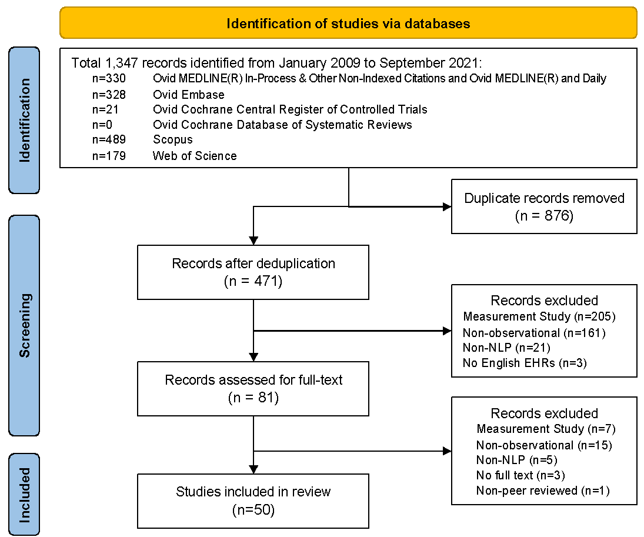
Data sources, search strategy and eligibility screening
Duration: January 2009 to September 2021
Inclusion: observational studies focusing on the use of NLP solutions to address clinical questions within the standard design of EHR-based observational research
Process: de-duplication, title and abstract screenings, full text review

Slide 26
Observational Study vs. Measurement Study
 | Observational Study† | Measurement Study (Machine Learning)‡
Introduction | Background/rationale, research objectives | Background/rationale, research objectives
Methods | Study design, setting, participants, variables, data source/measurement, bias, study size, variables, statistical methods | Study setting, task definition, analysis plan, data collection, clinical labelling, sampling data preparation, model development, model evaluation
Results | Participants, descriptive data, outcome data, main results, other analyses | Final model performance
Discussion | Key results, limitations, interpretation, generalizability | Clinical implications, limitations of the model, unexpected results during the experiments
†STROBE Guideline Version 4. ‡Recommendations from Journal of Biomedical Informatics and Journal of Medical Internet Research

Slide 27
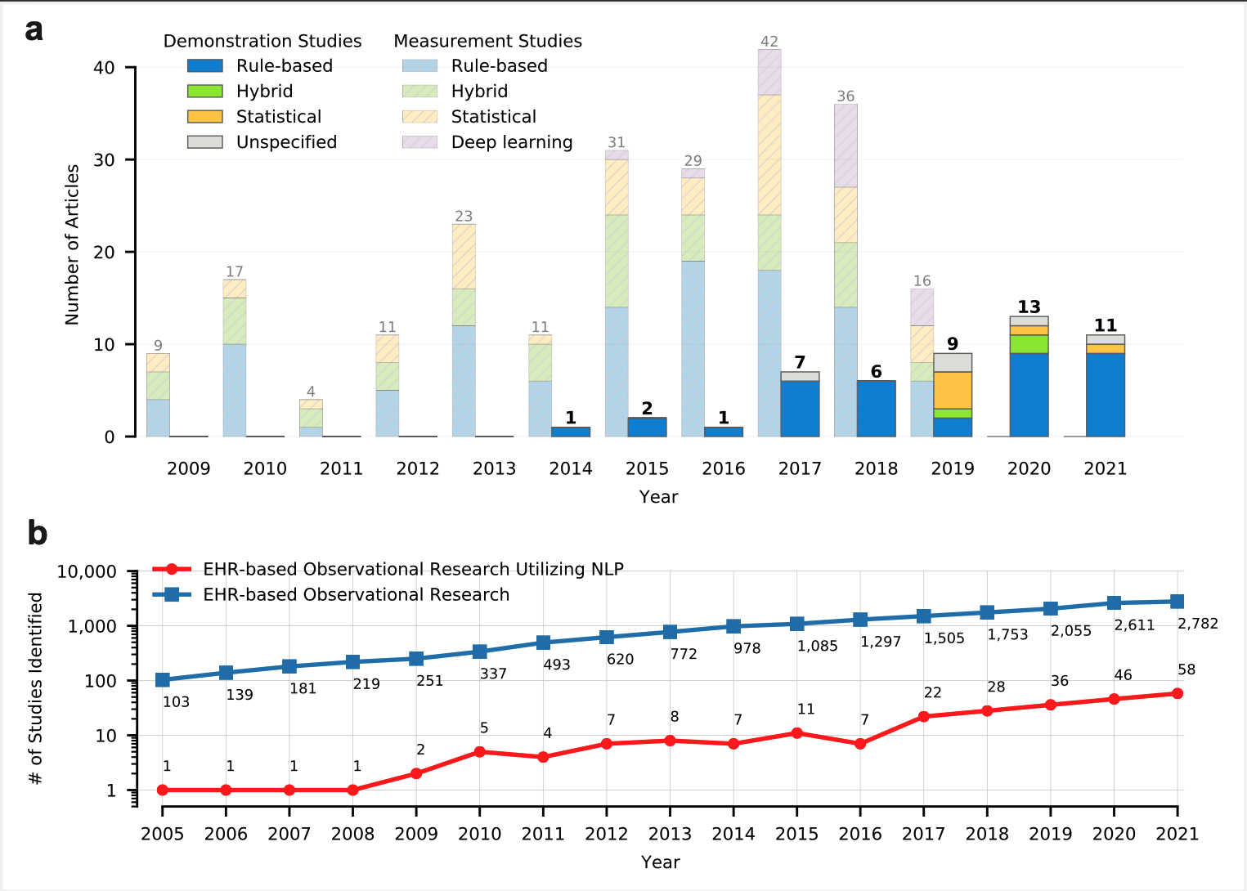
Trend view comparison of the number of EHR-based measurement and demonstration studies
An upward trend in the published NLP-assisted observational studies was observed.
Utilization of rule-based approach increased from 48% to 72% among the demonstration studies.
There is an adoption gap between EHR-based clinical research and those utilizing NLP
Fu S, Wang L, Moon S, Zong N, He H, Pejaver V, Relevo R, Walden A, Haendel M, Chute CG, Liu H. Recommended practices and ethical considerations for natural language processing‐assisted observational research: A scoping review. Clinical and translational science. 2023 Mar;16(3):398-411.

Slide 28
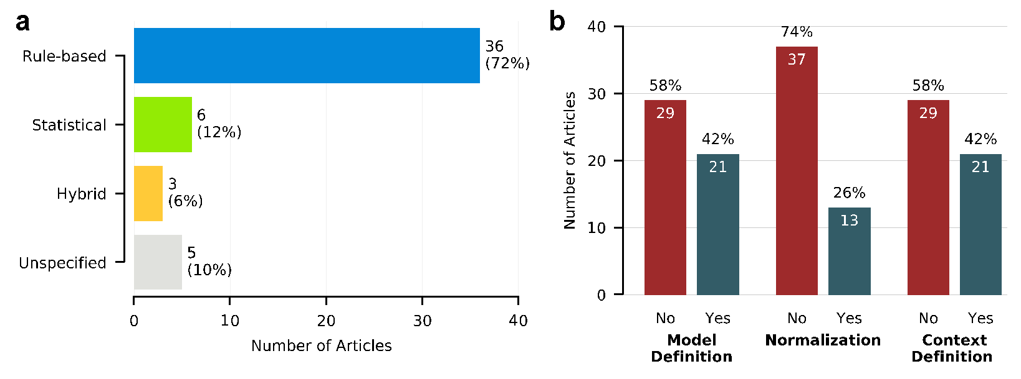
NLP methodology
10% studies did not specify the NLP method used.
58% of the studies did not report model definition (e.g., lexicon, dictionary, code, etc.)
74% of the studies did not report normalization techniques (e.g., UMLS, SNOMED CT)
58% of the studies did not report context definition (e.g., certainty, patient status [historical vs. present], experiencer [patient vs. family member])
Only 12% of the studies reported all three definitions
Fu S, Wang L, Moon S, Zong N, He H, Pejaver V, Relevo R, Walden A, Haendel M, Chute CG, Liu H. Recommended practices and ethical considerations for natural language processing‐assisted observational research: A scoping review. Clinical and translational science. 2023 Mar;16(3):398-411.

Slide 29
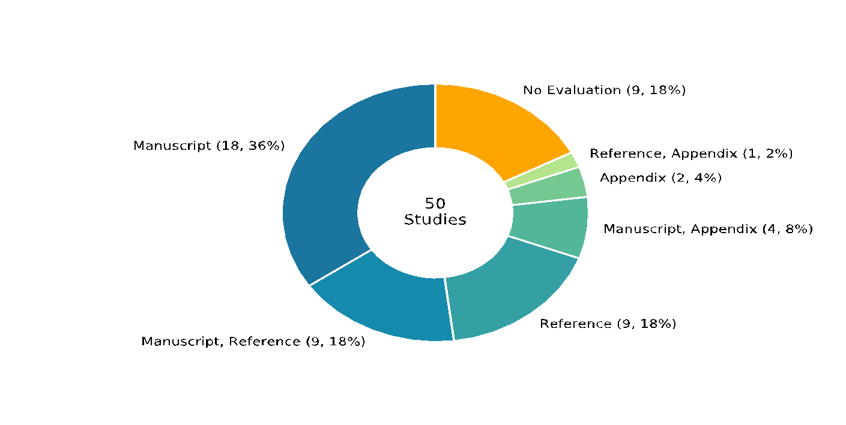
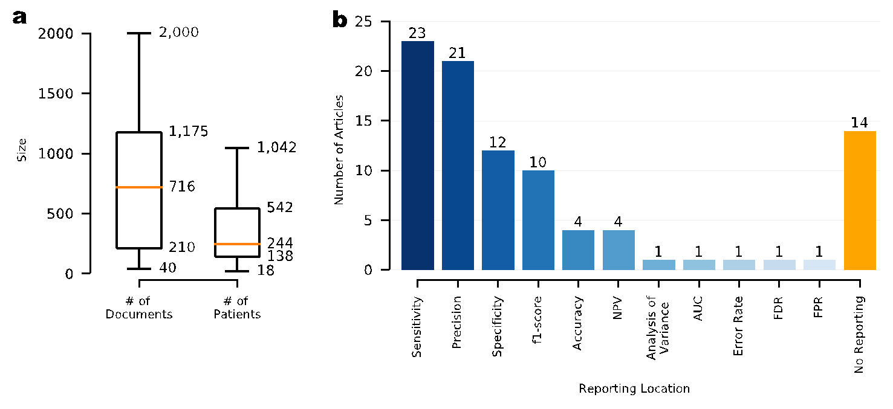
Gold standard development and evaluation
18 of studies did not report evaluation details.
The utilization of supplementary appendix for NLP reporting is low.
14% of studies did not report NLP methodology and evaluation
22% of studies did not report evaluation design
Overall moderate-poor reporting of the metadata of NLP in clinical research
Fu S, Wang L, Moon S, Zong N, He H, Pejaver V, Relevo R, Walden A, Haendel M, Chute CG, Liu H. Recommended practices and ethical considerations for natural language processing‐assisted observational research: A scoping review. Clinical and translational science. 2023 Mar;16(3):398-411.

Slide 30
An introduction to components in the OHNLP ecosystem
Andrew Wen, MS
Center for TEAM-AI, Department of Clinical and Health Informatics
McWilliams School of Biomedical Informatics, UTHealth Houston

Slide 31
Reproducible and robust data requires multi-institutional collaboration
Extends to NLP as well
Task definitions vary across sites
What constitutes a PASC-related sign/symptom?
Differences in documentation practices
What gets documented in what types of notes vs codified
Lexical differences
Mono-institutionally developed NLP generally has poor cross-site generalizability

Slide 32
Federated Algorithm development capabilities necessary
Textual data considered PHI
Not easily scrubbable, unlike structured data
Sure, statistical computational methods exist for De-ID, but how many institutions have signed off on these?
Implies that NLP needs to be run locally, evaluation done locally, and then errors aggregated and returned manually to coordinating sites
Cross-Institutional Tooling

Slide 33
NLP Infrastructure is non-trivial to set up, especially multi-institutionally at scale
Inputs/Outputs
Where to get notes from?
In a Computationally-Accessible Data Warehouse? Solr? MongoDB? BigQuery? Elasticsearch? Hive?
Streaming Data?
Just in a folder somewhere?
Data Service Pulls for You into Plaintext?
What format are they in?
(e.g. RTF typically needs to be converted to plaintext)
How to Subset the Data?
SQL Query? Elasticsearch Query? Cross-reference against preexisting list existing elsewhere?

Slide 34
NLP Infrastructure is non-trivial to set up, especially multi-institutionally at scale
“Large-Scale” Computational Infrastructure
Single Machine w/ Low CPU Core Count (Debug)
Single Machine w/ High CPU Core Count
Self-managed Hadoop/Spark Cluster
Databricks Spark Cluster on Azure
Google Cloud Platform Dataflow
Flink on Amazon Web Services
Streaming processing
using Samza to/from Kafka
using Spark to/from PubSub

Slide 35
Requiring new infrastructure setup for every algorithm development is untenable
Infrastructure-Flexible Tooling
It is a LOT easier to adapt software than to convince an institution to change their hardware infrastructure setups
You do NOT want to custom develop a separate solution for each institution
Minimal technical overhead to adopt/adapt
Task re-usable frameworks
Setup once, re-use across many use cases
Sure, in this case here we only wanted to do x, but are we really going to go through this entire setup process again the next time we want to run some NLP task?

Slide 36
Solution: OHNLP Toolkit
Configurator: GUI-based installer and pipeline editor for the OHNLP Toolkit Stack
Backbone: JSON-Configurable Run-Anywhere Scalable Execution Engine
Multiple I/O Options including File System, SQL-via-JDBC, BigQuery, Solr
Built in OHDSI CDM Support
Implemented on top of Apache Beam to Provide Scalability Across a Wide Variety of Computational Infrastructure (Spark, Flink, Dataflow)
Accompanying API for you to implement your own components and have it be immediately runnable
Plug and Play JSON-Configurable Components
MedTagger: Example NLP Engine Implementation Distributed by Default (Encourages Common Ruleset Specifications/Sharable and Easily Tweakable NLP Definitions)
MedTator: Front-end self-contained annotation interface for evaluation purposes, allowing all work to be done behind institutional firewalls before results are tabulated
Available at: https://www.github.com/OHNLP/{BackboneConfigurator|MedTagger|MedTator}

Slide 37
OHNLP Toolkit is Extensible!
Both Java and Python APIs Available and can be mixed together within one pipeline
Additional Available NLP Components
MedXN (Specialized for Medication Extraction)
FamilyHistoryNLP (Specialized for FH Detection and Associated Relation Extraction)
PresidioDeidentificationForOHNLPTK: Clinical Note De-Identification and PHI Resynthesis using Huggingface API-compatible NER models
API Specification available at
https://www.github.com/OHNLP/Backbone and https://www.github.com/OHNLP/backbone-xlang-python

Slide 38
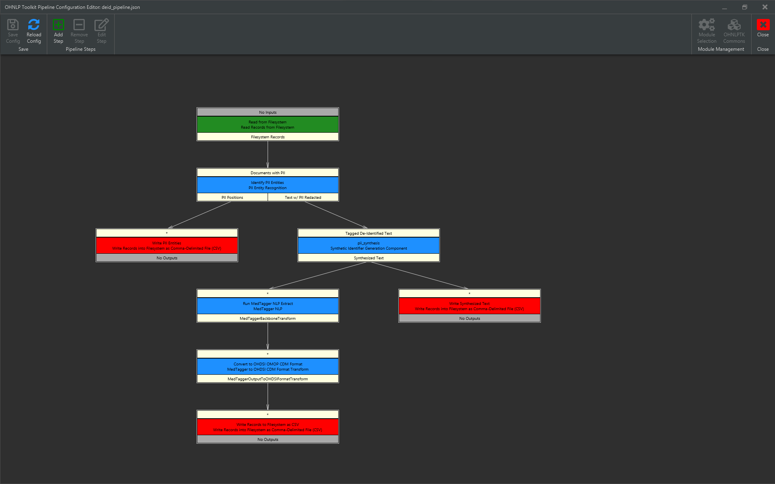

Slide 39
Break (15 min)

Slide 40
Hands-on: NLP Algorithm Development Process
Sunyang Fu, PhD, Liwei Wang, MD., PhD
Center for TEAM-AI, Department of Clinical and Health Informatics
McWilliams School of Biomedical Informatics, UTHealth Houston

Slide 41
Overview of NLP development
3.1 Task formulation
3.2 Model development
3.3 Experiment and evaluation
Corpus development
Shared task
Clinical task
Corpus development
Shared-task setting: either participation in or usage of resources produced from a shared-task to conduct concept extraction-related research
Clinical setting: (e.g., General Internal Medicine, Orthopedic Medicine) involves direct use of the EHR for concept extraction in real-world scenarios

Slide 42

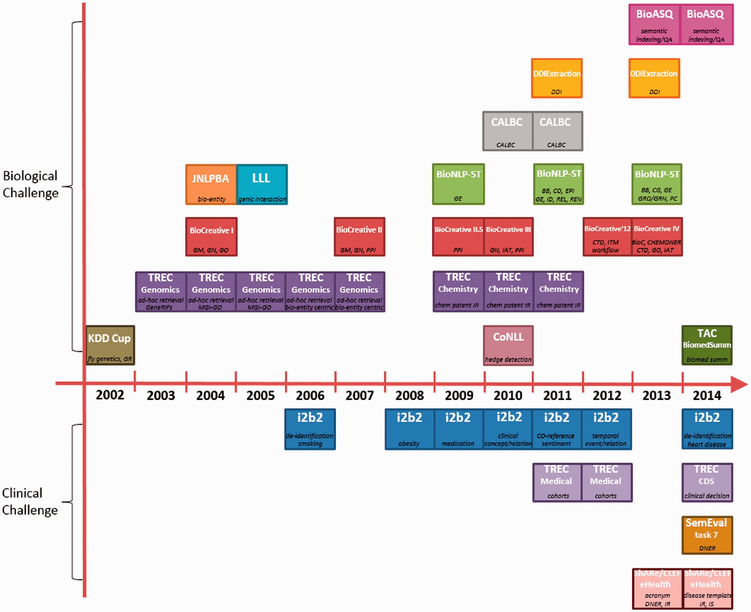
Shared-task
Key messages:
Challenge evaluations will continue playing critical roles in bio- and Biomedical NLP
The assessment of system scalability and interoperability should become important factors
A more collaborative competition framework can be coordinated in a more efficient and cost-effective manner
Brief Bioinform, Volume 17, Issue 1, January 2016, Pages 132–144, https://doi.org/10.1093/bib/bbv024
The content of this slide may be subject to copyright: please see the slide notes for details.

Slide 43
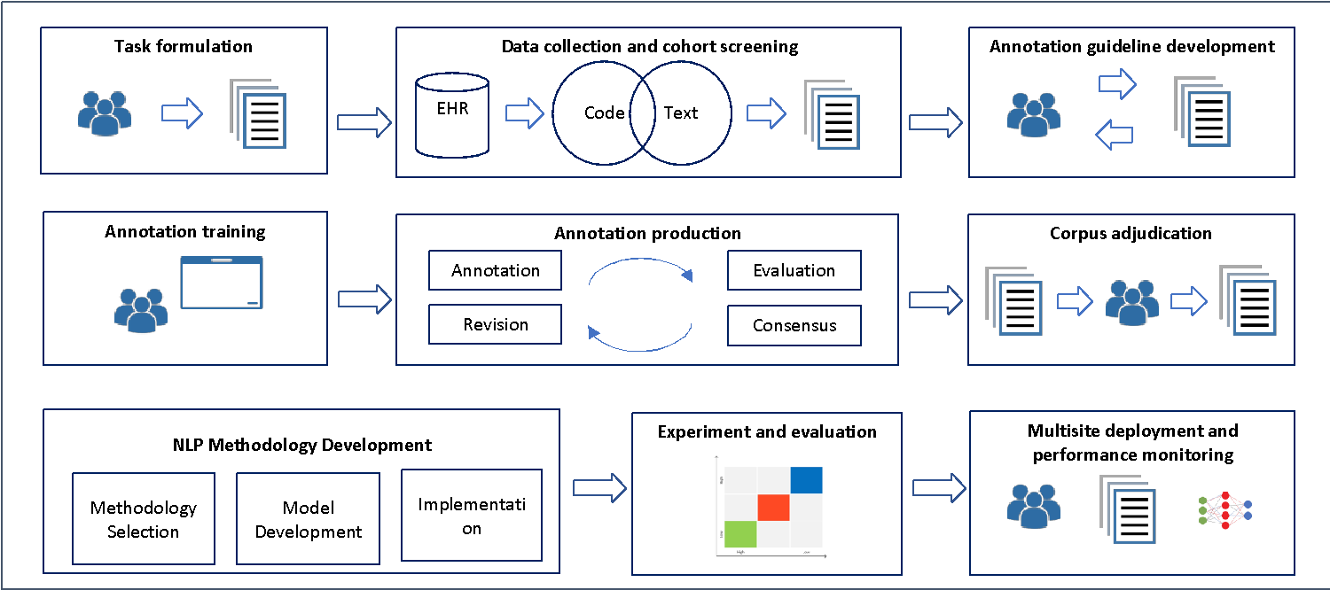
Clinical task

Slide 44
Task formulation and data preparation
Task formulation:
Definition of points of interest
Execution of a literature review
Consultation with domain experts
Identification of study stakeholders such as abstractors and annotators with specialized knowledge
Study Cohort: definition and/or creation of a study population or cohort.
For example, a concept extraction application of geriatric syndromes was developed based on the cohort of 18,341 people who were 1) 65 years or older, 2) received health insurance coverage between 2011 and 2013 and 3) were enrolled in a regional Medicare Advantage Health Maintenance Organization
Data Collection: customized application programming interface and SQL queries for automatic screening and retrieval

Slide 45




Corpus annotation
Corpus annotation is the process of manual chart review, marking interpretative linguistic (eg, syntax, negation) or predefined clinical information (eg, clinical concepts) to a corpus that can be used for NLP algorithm development and evaluation
Segmentation task: highlight
E.g., “This patient does not have chronic pain”
Labeling task: assign one or more pre-defined labels to the given concept or sentence
E.g., ““This patient does not have chronic pain” (Chronic pain: no)
Corpus Annotation
Chart Review
Gold Standard
Comparison
Evaluation
Statistics
Rule sets/ML
NLP system

Slide 46
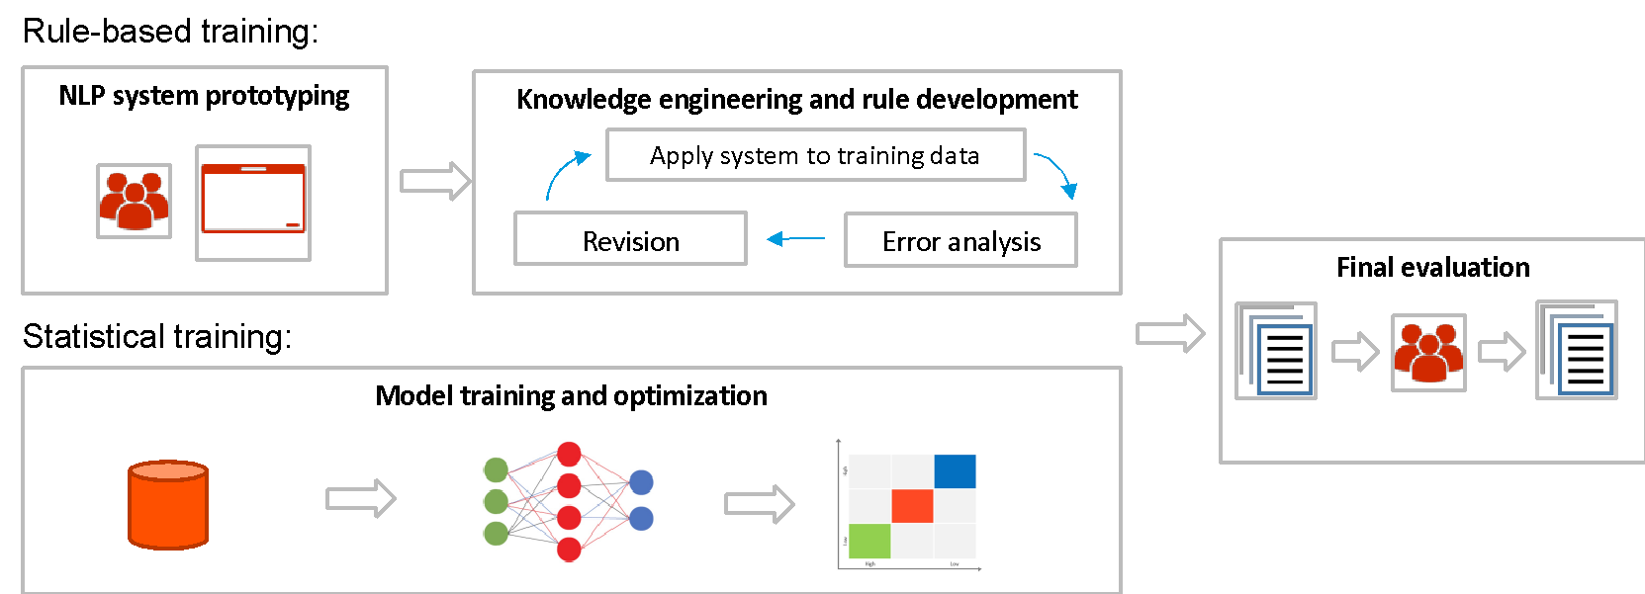
NLP system development
Three major approaches: rule-based, statistical machine learning (traditional ML and deep learning) and hybrid

Slide 47
NLP evaluation
Evaluation level: patient level, document level, concept level, or episode level
Confusion matrix or a contingency table
Common evaluation metrics for NLP: f1-score, sensitivity, specificity, precision, negative predictive value
Additional consideration:
Robustness (e.g., whether the performance can remain stable over time)
Portability and generalizability (inter- vs. intra-institutional)
Reproducibility, transparency and explainability
Performance bias/AI bias

Slide 48
Case study - introduction and overview
Adverse events of COVID-19 vaccines
Data sources
Adverse events of COVID-19 vaccine from Vaccine Adverse Event Reporting System (VAERS)
Public de-identified clinical data
Tasks
Name entity recognition
Fever, pain
From annotation to implementation
Relation annotation
Pain + severity

Slide 49
Link to Github: https://github.com/OHNLP/AMIAISWorkshop2024
Please download:
“Annotation Sample” that includes
Schema
Annotation Guideline
raw_text
MedTator annotation output example

Slide 50
Case study - introduction and overview
1) Fever
Definition: Elevated body temperature due to failed thermoregulation.|Hyperthermia is defined as a temperature greater than 37.5-38.3 degree celsius (100-101 degree Fahrenheit).
Definition reference: Human phenotype ontology (HPO)
HPO code: HP:0001945
Cross References: UMLS:C0015967, SNOMEDCT_US:50177009, SNOMEDCT_US:386661006, MSH:D005334
Patient ID: 123123
Radiology Report ID: 321321
Documentation Date: 06/01/2020
Findings: Temperature 38.5° temporal, recheck
<!ENTITY name "COVID_AES_AMIA">
<!ELEMENT Fever ( #PCDATA ) >
<!ATTLIST Fever certainty ( Positive | Negated | Hypothetic | Possible ) #IMPLIED "Positive" >
<!ATTLIST Fever comment CDATA "">
Annotation Guideline
Annotation Tool and scheme
Annotation corpus

Slide 51
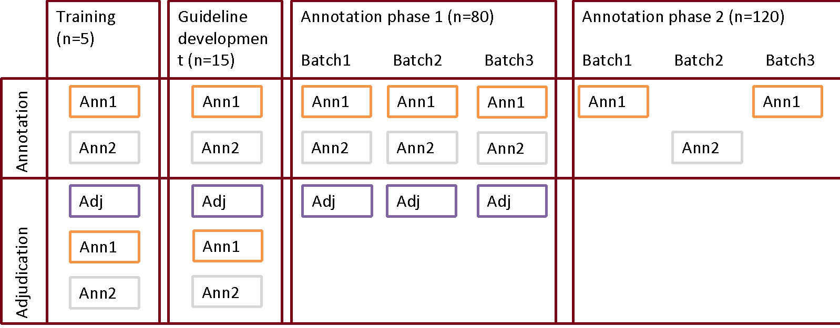
Case study - introduction and overview
Planning: literature review, approach domain experts, define the nature of the annotation task
Training: get familiar with the annotation tool and definitions of interest
Guideline Development: apply annotation to sub-sample notes, measure agreement, hold consensus meeting, revise guideline
Annotation Production: around 2-3 iterations, mid-point check-in
Annotation Adjudication: direct overwrite (performed by annotators or a third Independent domain expert), majority vote

Slide 52
NLP evaluation
F1-score or F-measure: well-established metric in the information retrieval community (Hripcsak and Rothschild)
Advantage: good at dealing with imbalanced data
Many NLP tasks contains high percentage of number of the true negatives (TN)

Slide 53
NLP evaluation
Gold standard
 |  | Gold standard
 |  | Fever | No Fever | Total
NLP | Fever | 20 (TP) | 5 (FP) | 25
 | No Fever | 10 (FN) | 15 (TN) | 25
 | Total | 30 | 20 | 50
Sensitivity = TP / (TP + FN)
Specificity = TN / (FP + TN)
Precision = TP / (TP + FP)
NPV = TN / (TN + FN)
F1 = 2Pre*Recall / (Precision + Recall)
Sensitivity =
Specificity =
Precision =
NPV =
F-score =

Slide 54
NLP evaluation
 |  | Gold standard
 |  | Fever | No Fever | Total
NLP | Fever | 20 (TP) | 5 (FP) | 25
 | No Fever | 10 (FN) | 15 (TN) | 25
 | Total | 30 | 20 | 50
Sensitivity = TP / (TP + FN)
Specificity = TN / (FP + TN)
Precision = TP / (TP + FP)
NPV = TN / (TN + FN)
F1 = 2Pre*Recall / (Precision + Recall)
Sensitivity = (20) / (20 + 10) = 0.67
Specificity = (15) / (5 + 15) = 0.75
Precision = (20) / (20 + 5) = 0.80
NPV = (15) / (15 + 10) = 0.60
F-score = 2* 0.67 * 0.80 / (0.67 + 0.80) = 0.73

Slide 55
Hands-on: Gold standard annotation using MedTator
Liwei Wang, MD., PhD
Center for TEAM-AI, Department of Clinical and Health Informatics
Williams School of Biomedical Informatics, UTHealth Houston

Slide 56
MedTator
https://medtator.ohnlp.org/
https://github.com/OHNLP/MedTator
MedTator is a serverless text annotation tool for corpus development.
Could use the latest web browser to run MedTator, such as Chromium, Microsoft Edge, Google Chrome, Vivaldi, and other Chromium-based browsers.
MedTator couldn’t run in Internet Explorer.

Slide 57
MedTator
Import schema and text files
Schema file
Text files
Sample
Converter
Schema development and revision
Annotate files
File Label
Display Mode (Document, sentence)
Entity label
Relation label
Analyze the annotations
Statistics
Export the annotations
Save annotation files
Export various formats
Adjudication

Slide 58
Now we go to MedTator
https://medtator.ohnlp.org/

Slide 59
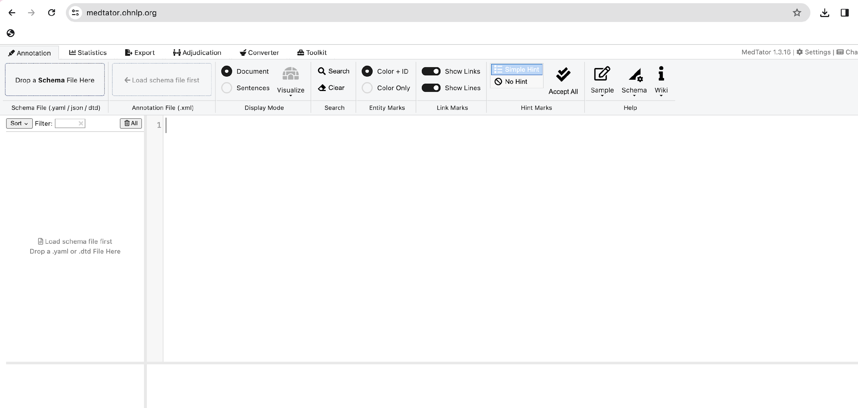

Slide 60
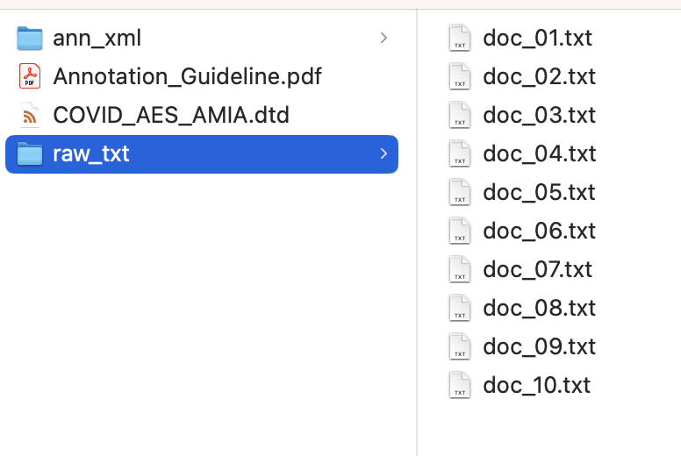
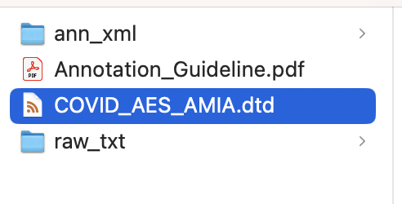

Slide 61
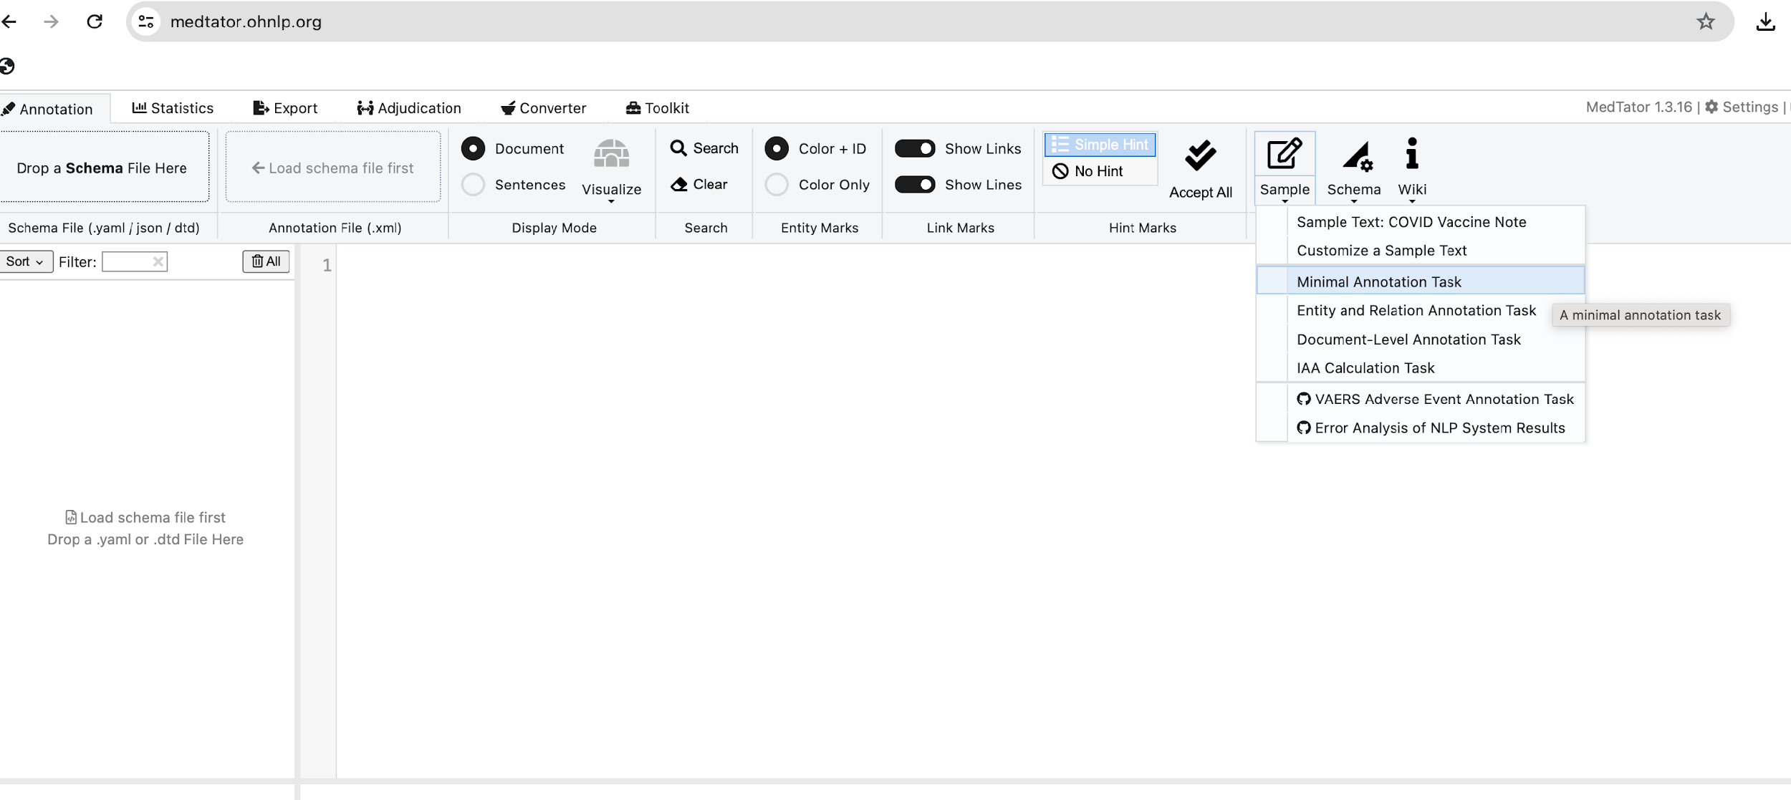
Sample

Slide 62
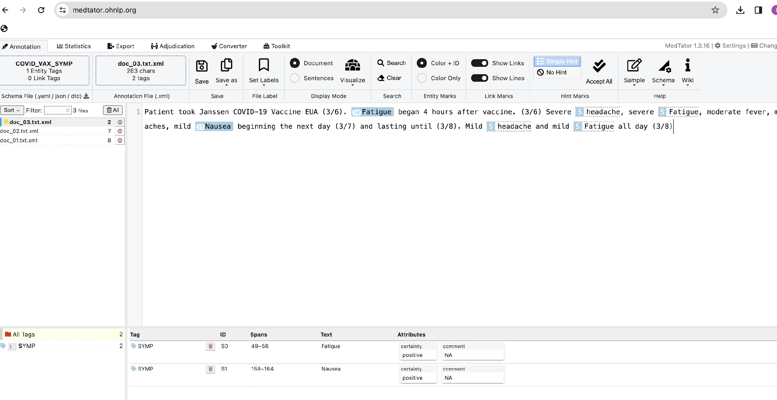
Sample

Slide 63
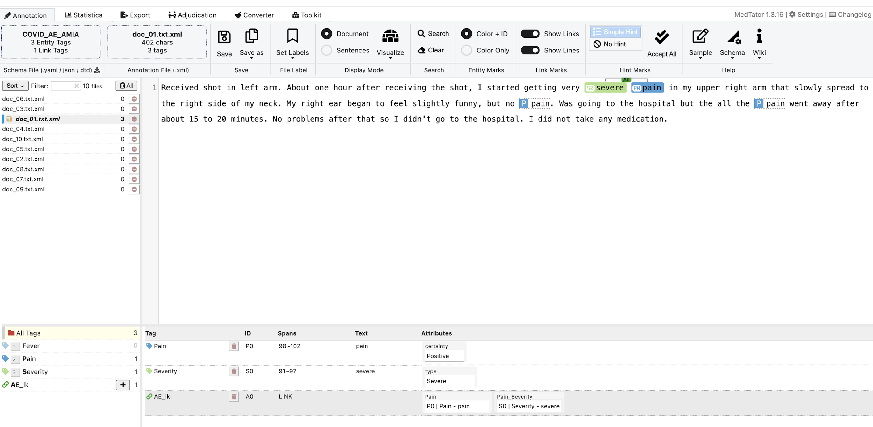
Annotation

Slide 64
Functions

Slide 65
Hands-on: NLP Ruleset Development using the MedTagger Web Interface
Sunyang Fu, PhD
Center for TEAM-AI, Department of Clinical and Health Informatics
McWilliams School of Biomedical Informatics, UTHealth Houston

Slide 66
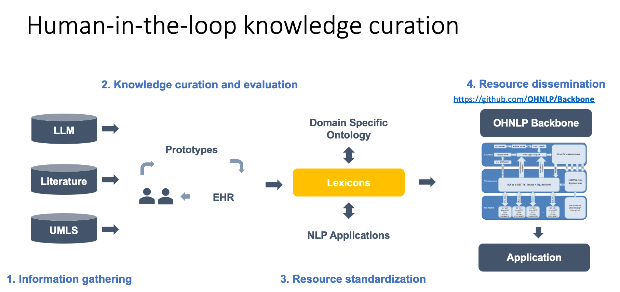

Slide 67
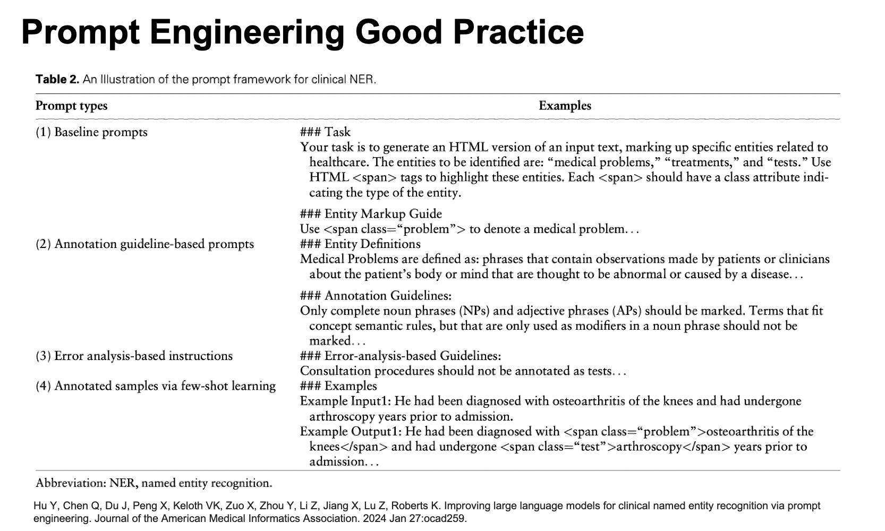

Slide 68
Web Demo
OHNLP Rule Editor: https://ohnlp.org/ohnlptk/ie_editor.html
Literature: https://academic.oup.com/jamia/article/30/12/2036/7239870
UMLS: https://uts.nlm.nih.gov/uts/umls/concept/C0013404
LLM: https://chat.openai.com/

Slide 69
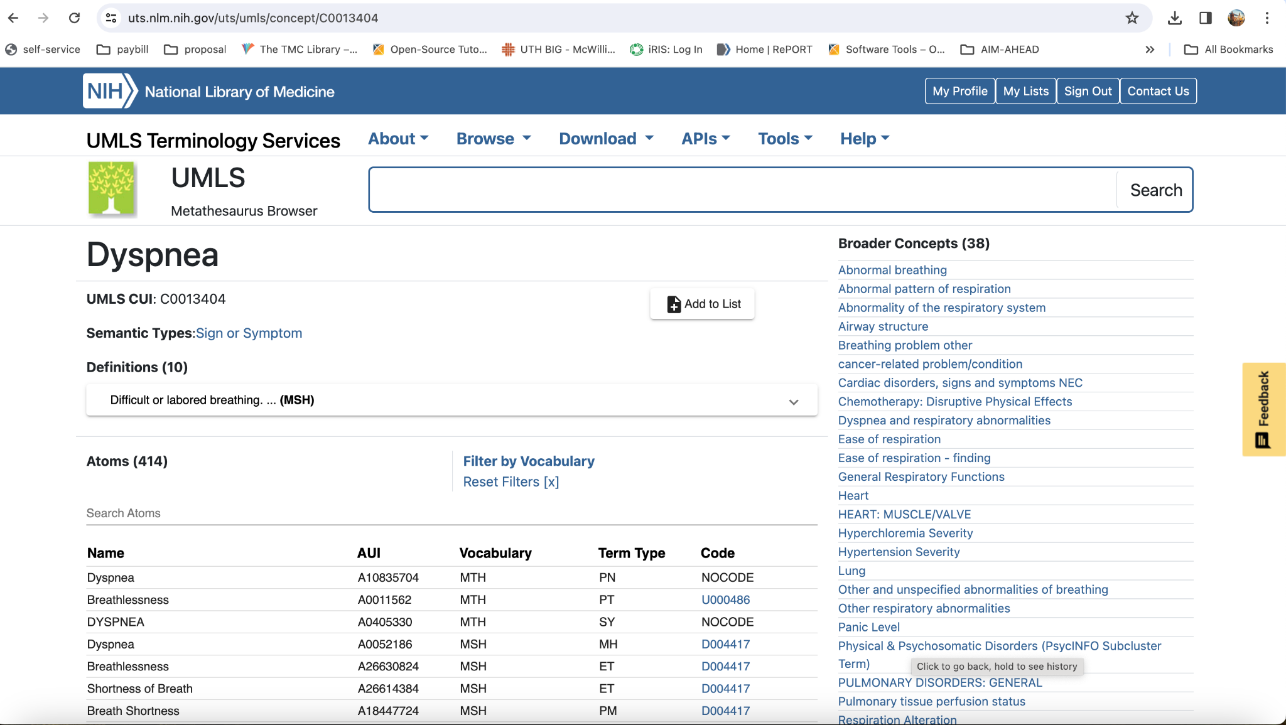

Slide 70
Prompt Engineering
You are an NLP researcher with the goal to develop a rule-based NLP system for delirium concept identification.
Read the provided dictionary list and generate more variations including potential human spelling errors, key words and regular expression phrases. Input dictionary list is
dyspnea
shortness of breath
s.o.b.
respiratory difficulty
Please provide output as a list of expanded dictionary.

Slide 71
Example Output
Dictionary List:
dyspnea, dyspnoea, breathlessness, difficulty breathing, trouble breathing, labored breathing, gasping for air, panting, wheezing, choking sensation, air hunger, suffocation sensation, chest tightness, respiratory distress, exertional dyspnea, orthopnea, paroxysmal nocturnal dyspnea, tachypnea, bradypnea, apnea, irregular breathing
Regex List:
dyspne(a|ia), short(n?e?s?s?)\s?of\s(breath|air), (breath|air)\s?(short(n?e?s?s?)|difficulty|problem), (respiratory\s)?(difficulty|distress|discomfort|trouble), (trouble|difficulty|problem)\sin\s(breathing|respiration), (labored|heavy|strained)\sbreathing, (gasping|panting|wheezing)\s(for\sair)?, (choke|suffocat(ion|ing))\s(sensation|feeling)?, (chest|thoracic)\stightness, (exertional|physical)\sdyspnea, (orthopnea|paroxysmal nocturnal dyspnea), (fast|rapid|quick)\sbreathing, (slow|irregular|abnormal)\sbreathing

Slide 72
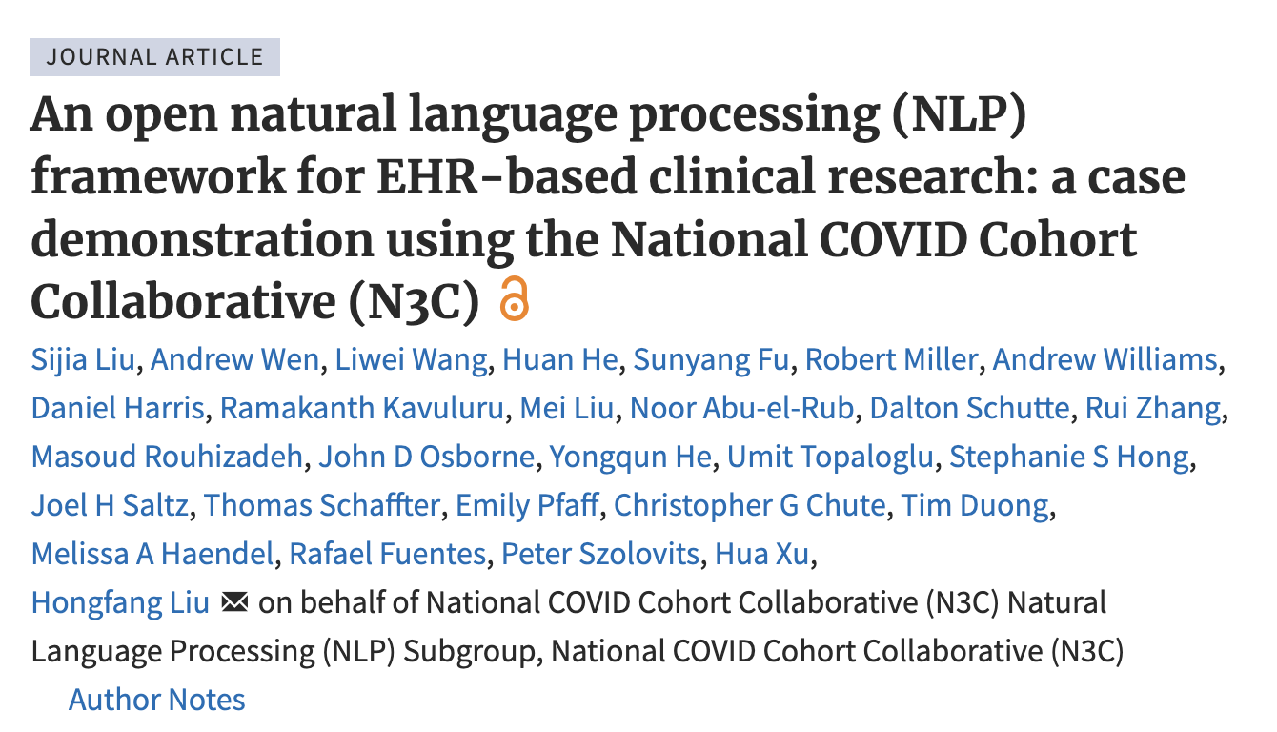
Concepts | No. Variants in original ruleset | Rule increase in multi-site version
Abdominal_pain | 16 | none
Chest_pain | 7 | none
Chill | 1 | none
Cough | 9 | none
Cyanosis | 5 | #UMN, add words between bluish(\s+\S+){0,5}\s*lips bluish(\s+\S+){0,5}\s*face
Delirium | 4 | //UK deilirium
Diarrhea | 8 | none
Dyspnea | 25 | //UMN WOB breathing issue\w{0,3} //UK shortness of air
Fatigue | 14 | //UK weak\w{0,5}

Slide 73
Hands-on: Evaluation of NLP output using MedTator
Liwei Wang, MD., PhD
Center for TEAM-AI, Department of Clinical and Health Informatics
McWilliams School of Biomedical Informatics, UTHealth Houston

Slide 74
Aim
To generate MedTator xml format based on NLP output using MedTator
To evaluate the NLP output in MedTator xml format against the gold standards using MedTator

Slide 75
Resources
Link to Github: https://github.com/OHNLP/AMIAISWorkshop2024
Please download:
“Evaluation_MedTator_Demo” that includes
Raw text file: example.txt
NLP output file: example.txt.ann
Example script to process the NLP output file: format.pl
Use your own script to process your NLP output format to align with Schema
PASC annotation schema file: pasc_v1.dtd

Slide 76
NLP output example
example.txt CM text="Brain fog" start=”0" end=”9" certainty="Positive" status="Present" experiencer="Patient" norm="1990033630" semG="FIND_HPO" section="DocBegin" sentid="DocBegin:47" sentence="Brain fog, dyspnea, post exertional malaise are all still very bothersome for her."

Slide 77
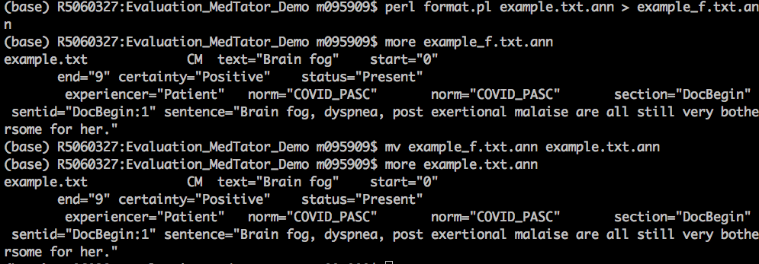
To generate MedTator xml format based on NLP output
1. Process the NLP output file to make it consistent with the schema
perl format.pl example.txt.ann > example_f.txt.ann
mv example_f.txt.ann example.txt.ann

Slide 78
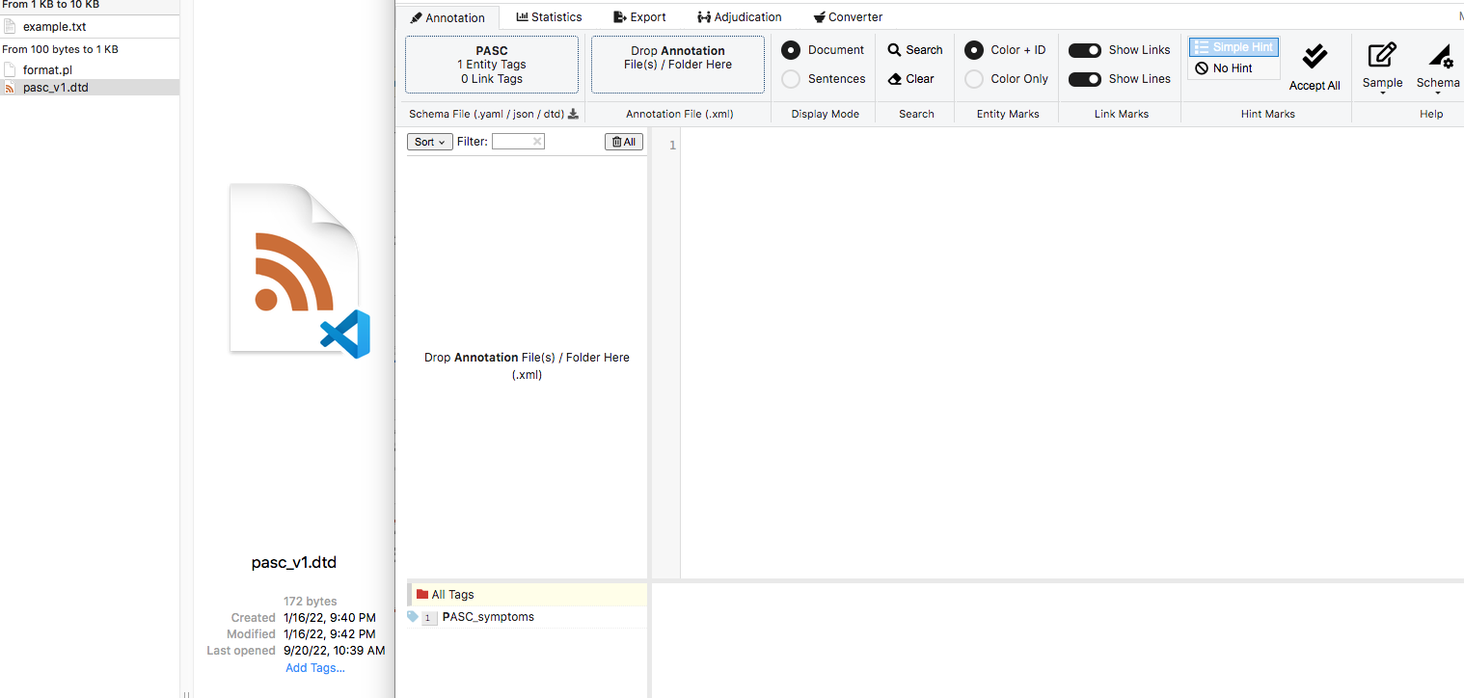
To generate MedTator xml format based on NLP output
2. Upload the schema file, pasc_v1.dtd to MedTator

Slide 79
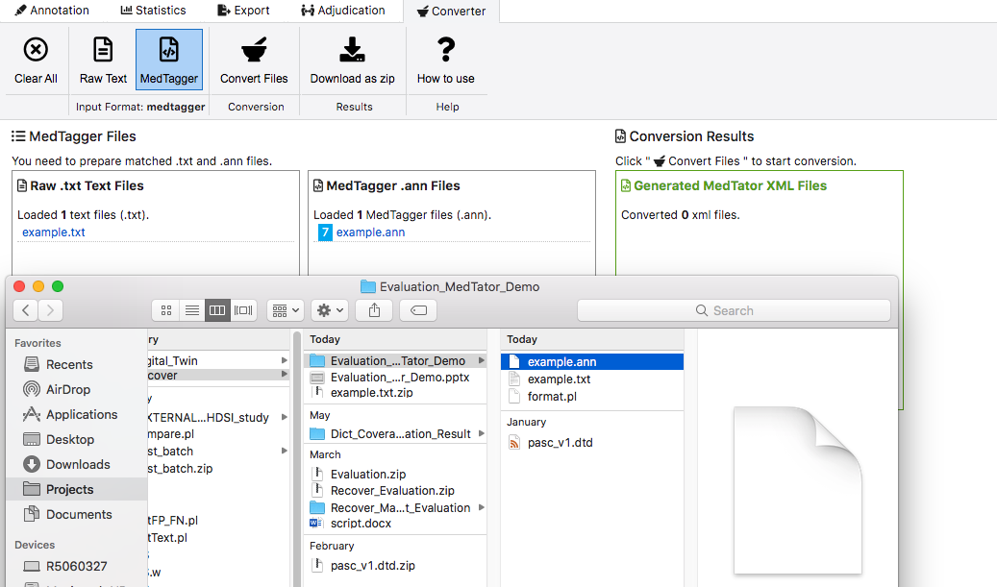
To generate MedTator xml format based on NLP output
3. Convert NLP output (ann) to Medtator format (xml)
3.1 Choose “Converter” Button
3.2 Choose “MedTagger” format
3.3 Drag example.txt to the box of “Raw .txt Text Files”
3.4 Drag example.txt.ann to the box of “MedTagger .ann Files”
3.5 Click “Convert Files” Button
3.6 Click “Download as zip” Button, a zip file containing the xml file will be downloaded.

Slide 80
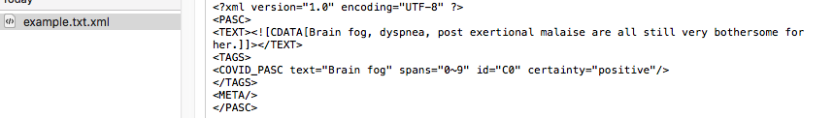
The generated xml file

Slide 81
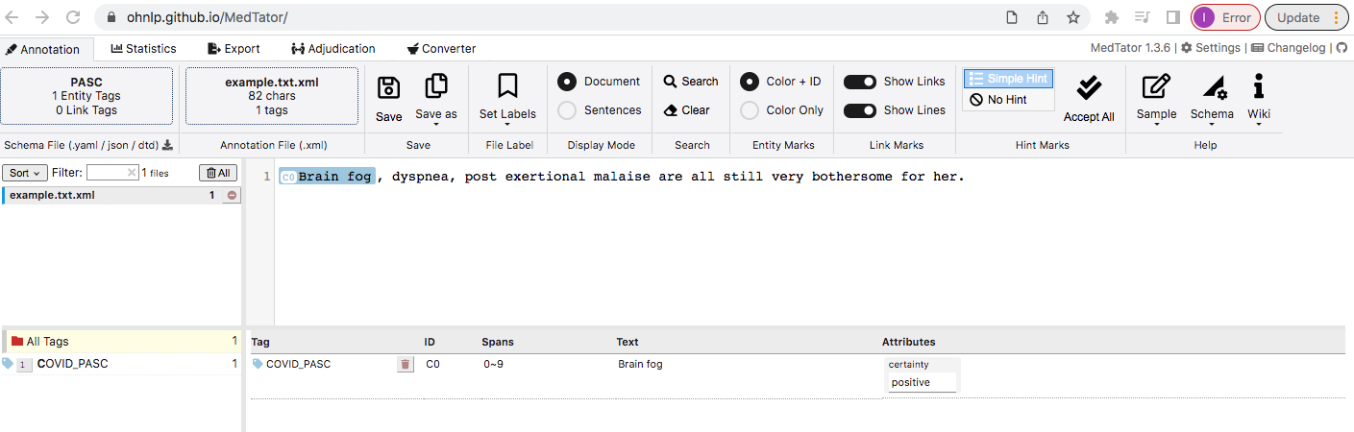
To generate gold standards based on NLP output
4. Modify NLP output (xml) to generate gold standards
4.1 Click “Annotation” button
4.2 Drag example.txt.xml to the box of “Drop Annotation Files(s)”
4.3 Click example.txt.xml

Slide 82
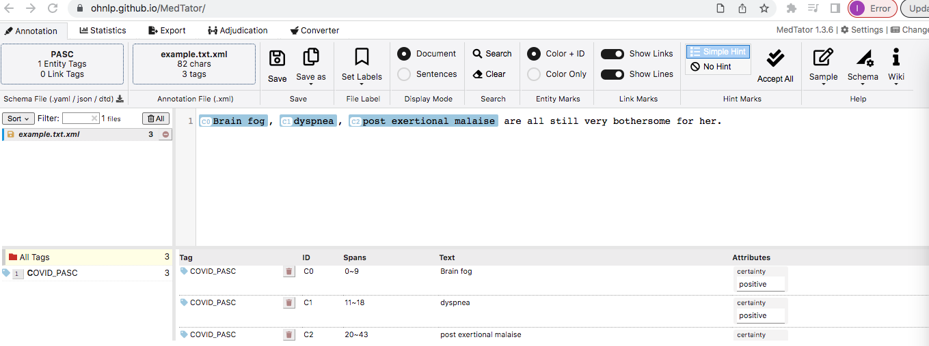
To generate gold standards based on NLP output
4.4 Revise annotations

Slide 83
To generate gold standards based on NLP output
4.5 Save as a new file, copy_of_example.txt.xml, which is the gold standard.

Slide 84
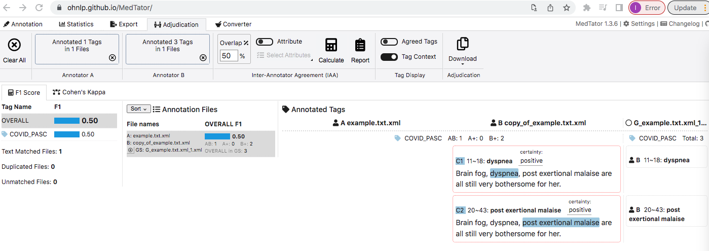
To evaluate NLP output against the gold standards using MedTator
1. Click “Adjudication” button
2. Drop example.txt.xml to the box of “Drop Annotation File(s)”—Annotator A, drop copy_of_example.txt.xml to the box of “Drop Annotation Files(s)”—Annotator B.
3. Defaulted overlap % is 50%, you can change according to your requirements.
4. Click “Calculate”, evaluation results will be displayed (F1)

Slide 85
Error Analysis
Error analysis: a process that involves manually reviewing NLP errors (after an NLP model run) made during classification or extraction tasks. It aims to identify the appropriate rationale, such as contextual or linguistic contributors to the error causes, and create a corresponding revision plan.
Error analysis versus corpus annotation:
•Both tasks are iterative, time consuming, and require extensive manual effort
•More difficult: requiring understanding of both medical and NLP tasks
•Less determinant: not all errors can be fully understood
Current gap: no recognized framework for systematic error analysis. In particular, there are no common definitions for various heterogeneous error types.
Primary goal: to develop, evaluate, and disseminate a systematic error analysis framework to enhance NLP model reproducibility and portability to promote multi-site EHR-based concept extraction studies.

Slide 86
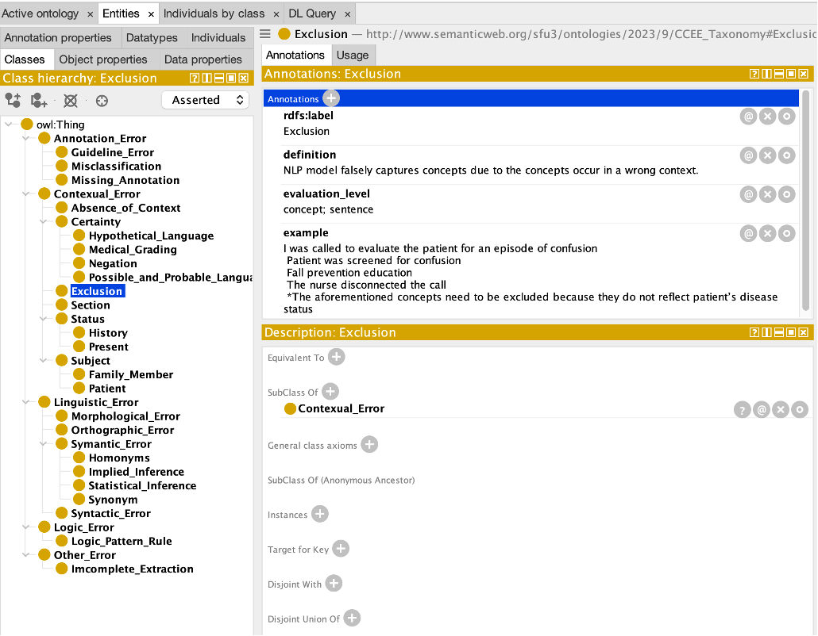
Error Analysis
Version: CCEE_v_1.0
32 unique error classes grouped by six error dimensions:
•Logic Error
•Linguistic Error
•Contextual Error
•Annotation Error
•Other Error
•
•
Four properties including
•Model type
•Evaluation subject
•Evaluation level
•Example
https://github.com/OHNLP/ErrorAnalysis

Slide 87
Hands-on: a walk-through of installing/deploying the OHNLP Toolkit on your institutional infrastructure
Andrew Wen, MS
Center for TEAM-AI, Department of Clinical and Health Informatics
McWilliams School of Biomedical Informatics, UTHealth Houston

Slide 88
Hands-on: Installing Third Party Components to add De-Identification to the Pipeline
Andrew Wen, MS
Center for TEAM-AI, Department of Clinical and Health Informatics
McWilliams School of Biomedical Informatics, UTHealth Houston

Slide 89
Thank you!

Slide 90
More to come

Slide 91
Mar 18, 2024 3:30 AM - 5:00 PM SDOH: Insights, Interpretations, and Innovations
Sunyang Fu - Knowledge Engineering of Lexicon Resources of Food and Housing Insecurity from Multi-source Evidence
Mar 19, 2024 5:00 AM - 6:30 PM EDT Poster Session 1
Wednesday, Mar 20, 2024
Xiaoyang Ruan - GRU-D-Weibull: A Novel Real-Time Individualized Endpoint Prediction

Slide 92
Mar 20, 2024 10:30 AM - 12:00 PM Omics Insights and Novel Statistical Approaches
Jinlian Wang - Prioritizing Clinically Significant Lung Cancer Somatic Mutations for Targeted Therapy Through Efficient NGS Data Filtering System
Mar 20, 2024 3:30 AM - 5:00 PM EDT
Hongfang Liu - On Federated Development and Deployment of Post-Market Active Surveillance for Medical Device Safety: A Discussion on Opportunities and Challenges
Mar 20, 2024 5:00 AM - 6:30 PM EDT Poster Session 2
Wednesday, Mar 20, 2024
Liwei Wang - Detecting Favorable Effect of Combination Therapies on cardiotoxicity
Liwei Wang - OncoOpenIE – an Expert-Based NLP System for Precision Oncology
Hui Li - LIVES: An Interactive Living Evidence Synthesis System for Systematic Review and Meta-Analysis

Slide 93
Mar 21, 2024 10:00 AM - 11:30 PM
Hongfang Liu, Andrew Wen - On Federated Development and Deployment of Post-Market Active Surveillance for Medical Device Safety: A Discussion on Opportunities and Challenges

